Slide 1
INTRODUCTION TO CLOUD COMPUTING

Slide 2
INTRODUCTION TO CLOUD COMPUTING
Introduction to Cloud Computing
Why Cloud Computing?
What are benefits of Cloud Computing?

Slide 3
Definition of Cloud Computing
Cloud computing is the on-demand delivery of IT resources and apps through internet with pay-as-you-go pricing model.
Whether you run apps or deliver services that support the critical operations of your business, the cloud provides rapid access to flexible and low-cost IT resources.
With cloud computing, you don’t need to make large up-front investments in hardware/software and spend a lot of time managing that resources.

Slide 4

IT Resource Management

Slide 5
Definition of Cloud Computing
Cloud computing provides an easy way to access servers, storage, databases, and a broad set of application services over the internet.
Cloud computing providers such as AWS owns and maintain the network-connected hardware required for those application services, while you provision and use what you need for your workloads.

Slide 6
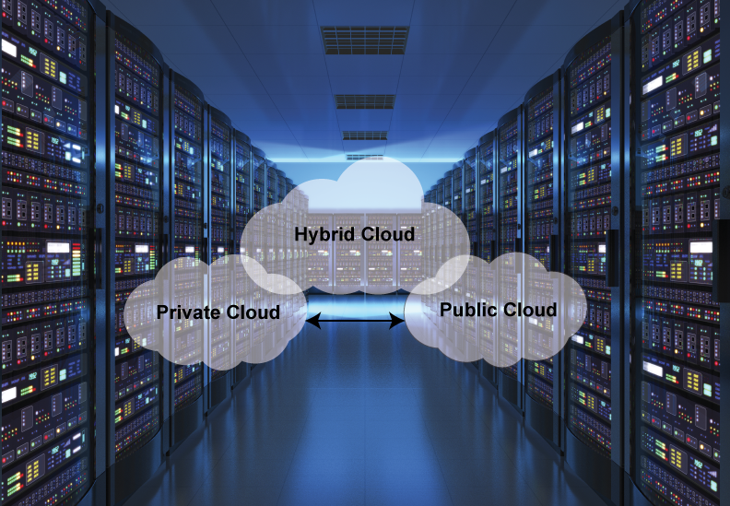
Hybrid Environment

Slide 7
WHY CLOUD COMPUTING ?
Many businesses large and small use cloud computing today either directly (e.g. Google or Amazon) or indirectly (e.g. Twitter) instead of traditional on-site alternatives.
Reduction of costs
Universal access
Up to date software
Choice of applications
Potential to be greener and more economical
Flexibility

Slide 8
BENEFITS OF CLOUD COMPUTING
Faster Deployments:
Because there’s no wait for local computing resources
Usage-based pricing:
Letting you pay only for what you use
Less financial risk:
With lower up-front investment in hardware and software
Easier upgrades:
With no on-premises software to update
Reduced need for on-premises resources:
such as servers and IT staff

Slide 9
DISADVANTAGES OF CLOUD COMPUTING
Security Issues:
Security is the major issue in cloud computing.
The cloud services implement the best security standards and industry certifications.
However storing data on an external service providers always bears a risk.
Technical Issues:
You always need to rely on the internet to uploading/downloading and migrating.

